Slide 1
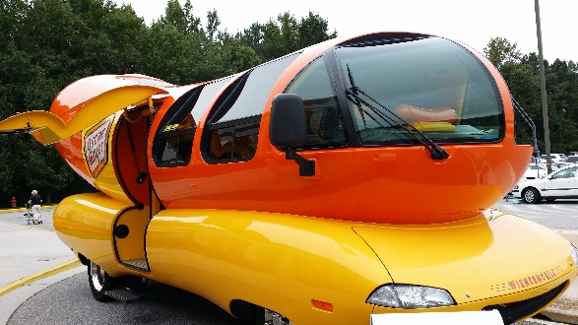
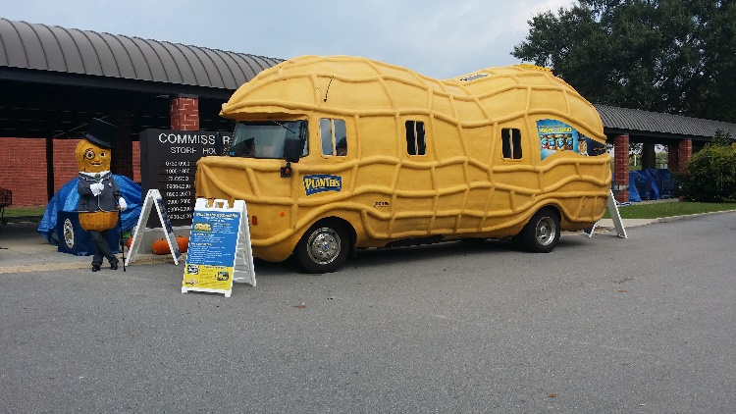
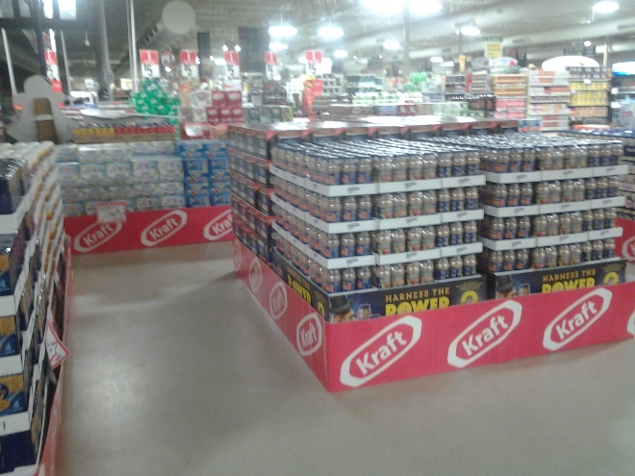
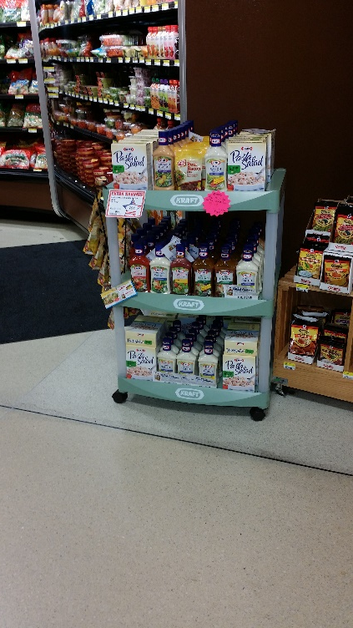
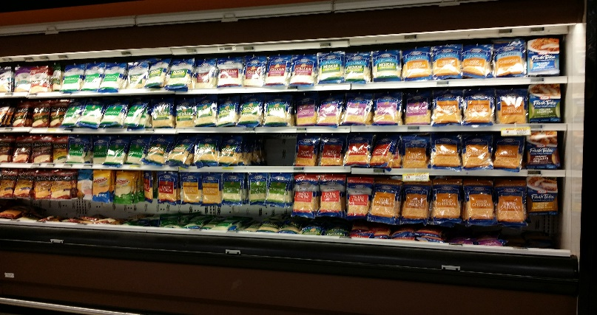
Performance At It’s Best
Consumer Excitement!
Mass Merchandising
Secondary Displays for Suggestive Selling
Optimization of Plan O Gram/ Product Placement on Shelf

